Slide 1

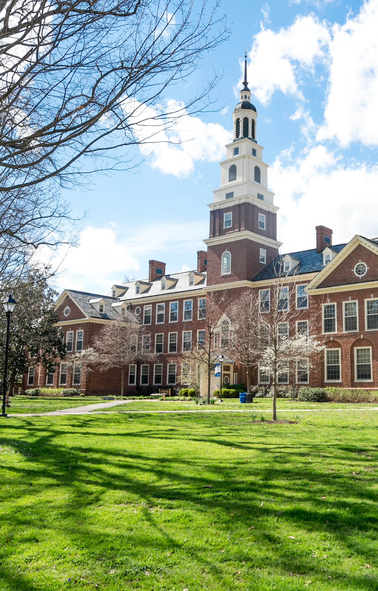
IT COLLEGE
Presented by : Matsi LF

Slide 2
PROGRAMS OFFERED
Theory | Practical
Electronics | Networking
System Development | Programming
Information Systems | Web Design

Slide 3
TUITION FEES(INCL.REGISTRATION)

Slide 4

REGISTRATION REQUIREMENTS
Grade 12 qualification with:
a. Mathematics C
b. Physical Science C
c. English D
This is the minimum requirements

Slide 5

FACILITIES AND INFRASTRUCTURE
Leading you towards the future!!!
Internet Facilities
Equipment for disabled students
E-learning & E-assessment
This Photo by Unknown Author is licensed under CC BY-SA-NC

Slide 6
STAFF STRUCTURE
J Ross General Manager
C Roslee Theory Courses
M Kelley Practical Courses
A Joe Languages
M Davids Lecturer
A Bokaba Lecturer

Slide 7
TUITION FEES(INCL.REGISTRATION)

